Slide 1
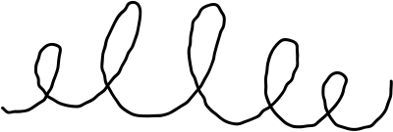


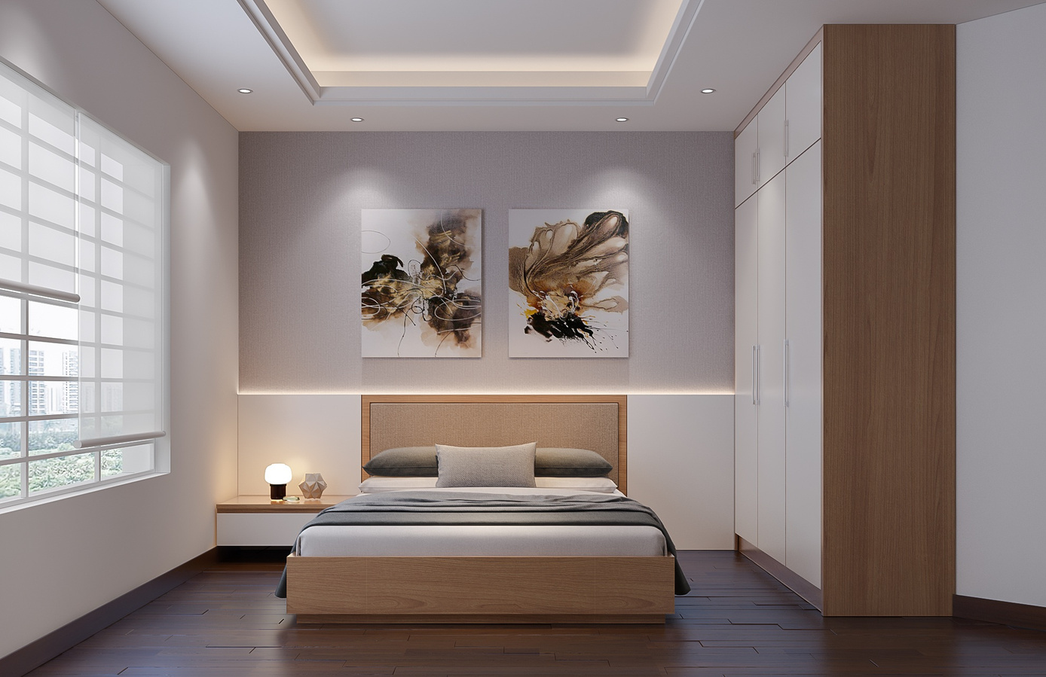



ModifAI
Project Update 3
Overview of progress and future plans for our AI-powered interior decor app

Slide 2
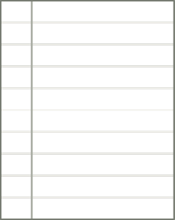





Team Introduction for ModifAI Project Update 2
Akram Hossain Apu Khan – 2231090642
Mehedi Hasan Dip – 2232167042
Together, we are transforming interior decor through AI technology.
Hacibull Hashan Tosher – 2111626642

Slide 3
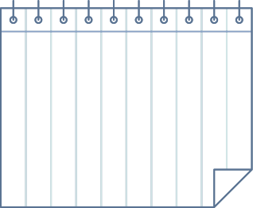

This Week's Progress (Update 3)
Chat System Implementation
Chat Interface Design
Home Page Connection
User Feedback Collection
The new chat system has been successfully added, allowing users to communicate efficiently within the app. This feature enhances user interaction and provides a platform for immediate assistance regarding decor choices.
We have developed a user-friendly chat interface that integrates seamlessly with the main app. This design prioritizes user experience, ensuring that users can easily navigate and utilize the chat function without confusion.
The chat system is now connected to the home page, enabling instant access for users. This integration improves the overall functionality of ModifAI, making it easier for users to engage with the app’s features.
We are actively collecting user feedback on the new chat system and interface. This feedback will guide further improvements, ensuring that ModifAI remains a personalized and efficient tool for interior decor.

Slide 4




Current Challenges: Addressing Issues with Chat API and Interface Bugs
Integration of the chat API has not yet been accomplished, causing delays.
Multiple bugs have been identified within the chat interface that hinder usability.
User feedback highlights a need for improved stability in the chat features.
Addressing these challenges is crucial for enhancing user experience and satisfaction.

Slide 5
Next Steps for Enhancing ModifAI's User Experience
Prioritize fixing the chat API for seamless communication.
Address existing bugs in the chat interface to improve stability.
Redesign UI elements for a more appealing user interface.
Conduct user testing to gather feedback and refine features.

Slide 6




Enhancing ModifAI for the Future
We are committed to improving ModifAI, ensuring it becomes the go-to app for interior decor. Our plans include adding more features and refining the AI to provide smarter, more personalized suggestions. We aim for a seamless user experience that caters to individual tastes and preferences. By focusing on enhancing the overall interface, we will make home decorating more accessible and enjoyable for everyone.

